Slide 1
Chapter 32 Java Database Programming

Slide 2
Objectives
To understand the concept of database and database management systems (§32.2).
To understand the relational data model: relational data structures, constraints, and languages (§32.2).
To use SQL to create and drop tables, and to retrieve and modify data (§32.3).
To learn how to load a driver, connect to a database, execute statements, and process result sets using JDBC (§32.4).
To use prepared statements to execute precompiled SQL statements (§32.5).
To use callable statements to execute stored SQL procedures and functions (§32.6).
To explore database metadata using the DatabaseMetaData and ResultSetMetaData interfaces (§32.7).

Slide 3
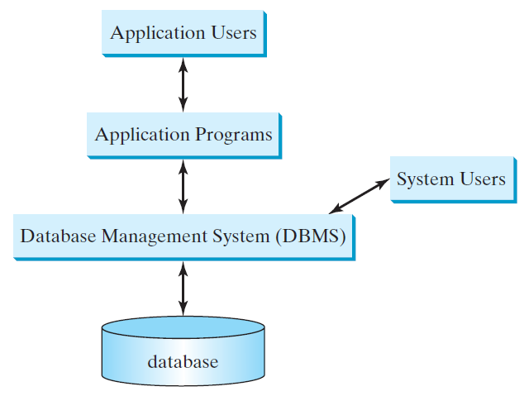
What is a Database System?
e.g., Access, MySQL, Oracle, and MS SQL Server

Slide 4
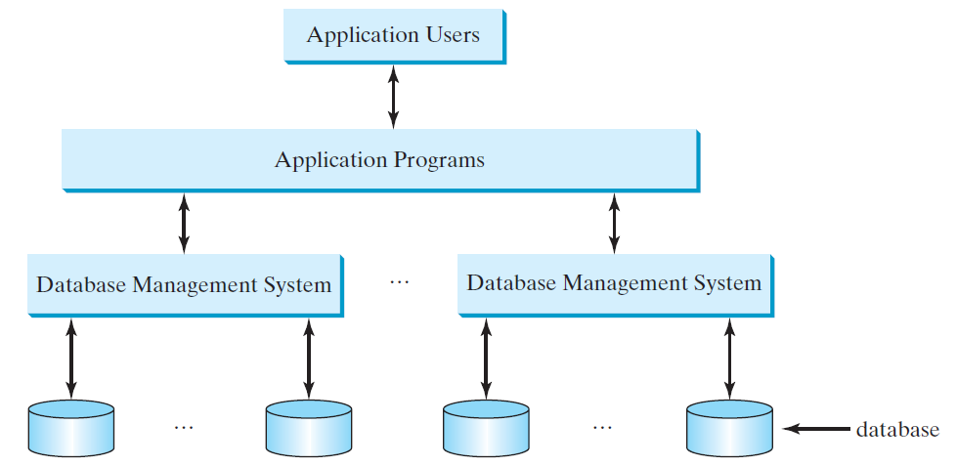
Database Application Systems

Slide 5
Relational Structure
A relational database consists of a set of relations. A relation has two things in one: a schema and an instance of the schema. The schema defines the relation and an instance is the content of the relation at a given time. An instance of a relation is nothing more than a table with rows and named columns. For convenience with no confusion, we refer instances of relations as just relations or tables.

Slide 6
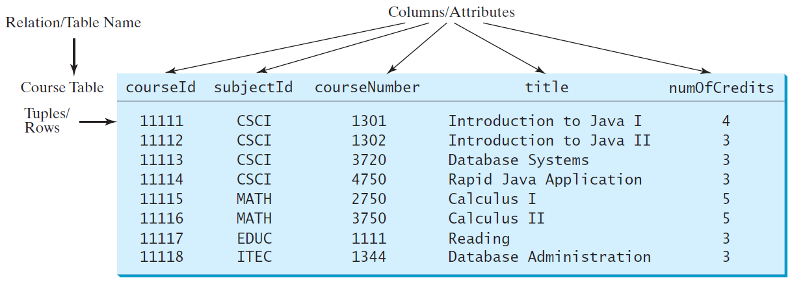
Course Table

Slide 7
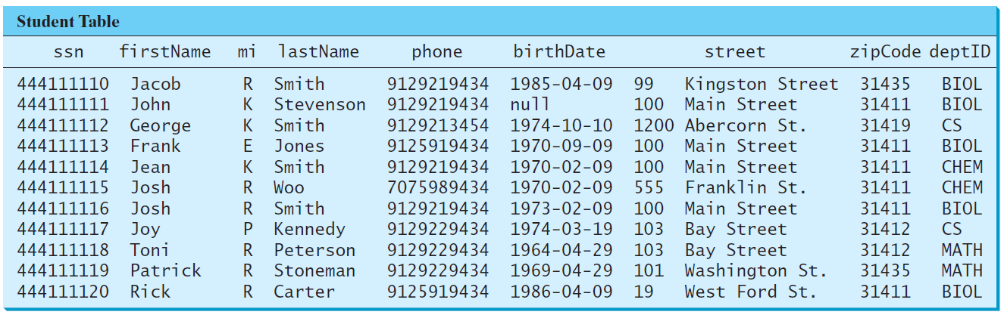
Student Table

Slide 8
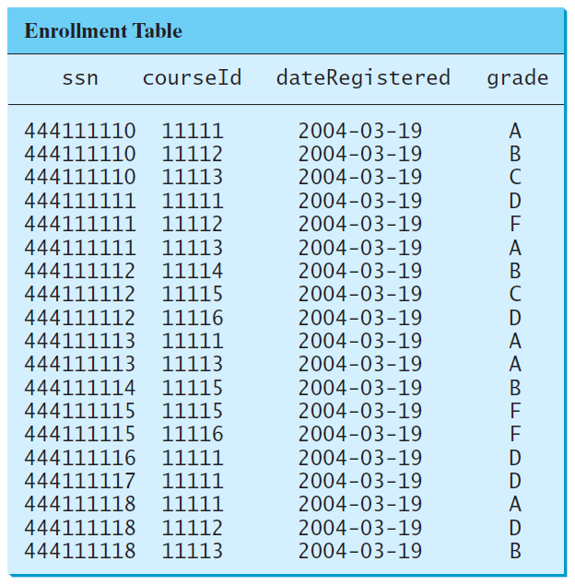
Enrollment Table

Slide 9
Table vs. File
NOTE:
A table or a relation is not same as a file. Most of the relational database systems store multiple tables in a file.

Slide 10
SQL
Structured Query Language, pronounced S-Q-L, or Sequel
To access or write applications for database systems, you need to use the Structured Query Language (SQL). SQL is the universal language for accessing relational database systems. Application programs may allow users to access database without directly using SQL, but these applications themselves must use SQL to access the database.

Slide 11
Examples of simple SQL statements
Create table
Drop table
Describe table
Select
Insert
Delete
Update
create table Course (
courseId char(5),
subjectId char(4) not null,
courseNumber integer,
title varchar(50) not null,
numOfCredits integer,
primary key (courseId)
);
create table Student (
ssn char(9),
firstName varchar(25),
mi char(1),
lastName varchar(25),
birthDate date,
street varchar(25),
phone char(11),
zipCode char(5),
deptId char(4),
primary key (ssn)
);

Slide 12
Examples of simple SQL statements
Create table
Drop table
Describe table
Select
Insert
Delete
Update
drop table Enrollment;
drop table Course;
drop table Student;

Slide 13
Examples of simple SQL statements
Create table
Drop table
Describe table
Select
Insert
Delete
Update
describe Course; -- Oracle

Slide 14
Examples of simple SQL statements
Create table
Drop table
Describe table
Select
Insert
Delete
Update
select firstName, mi, lastName
from Student
where deptId = 'CS';
select firstName, mi, lastName
from Student
where deptId = 'CS' and zipCode = '31411';
select *
from Student
where deptId = 'CS' and zipCode = '31411';

Slide 15
Examples of simple SQL statements
Create table
Drop table
Describe table
Select
Insert
Delete
Update
insert into Course (courseId, subjectId, courseNumber, title)
values ('11113', 'CSCI', '3720', 'Database Systems', 3);

Slide 16
Examples of simple SQL statements
Create table
Drop table
Describe table
Select
Insert
Update
Delete
update Course
set numOfCredits = 4
where title = 'Database Systems';

Slide 17
Examples of simple SQL statements
Create table
Drop table
Describe table
Select
Insert
Update
Delete
delete Course
where title = 'Database System';

Slide 18
Why Java for Database Programming?
First, Java is platform independent. You can develop platform-independent database applications using SQL and Java for any relational database systems.
Second, the support for accessing database systems from Java is built into Java API, so you can create database applications using all Java code with a common interface.
Third, Java is taught in almost every university either as the first programming language or as the second programming language.

Slide 19
Database Applications Using Java
  GUI
  Client/Server
  Server-Side programming

Slide 20
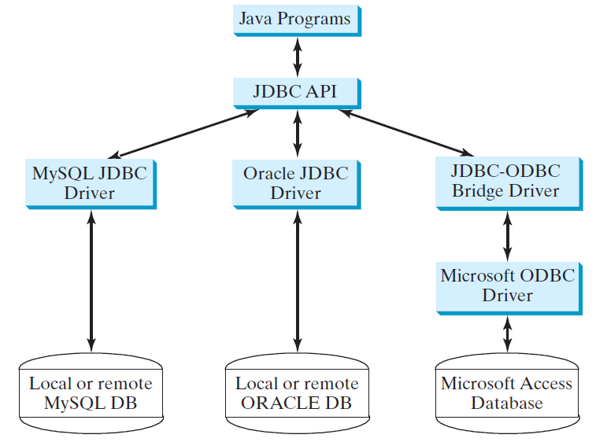
The Architecture of JDBC

Slide 21
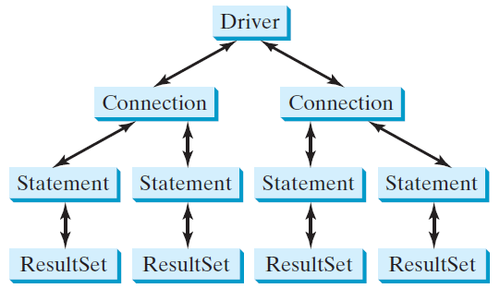
The JDBC Interfaces
Loading drivers
Establishing connections
Creating and executing statements
Processing ResultSet

Slide 22
Developing JDBC Programs
Loading drivers
Establishing connections
Creating and executing statements
Processing ResultSet
Statement to load a driver:
  Class.forName("JDBCDriverClass");
A driver is a class. For example:
Database Driver Class Source
Access sun.jdbc.odbc.JdbcOdbcDriver Already in JDK
MySQL com.mysql.jdbc.Driver Website
Oracle oracle.jdbc.driver.OracleDriver Website
The JDBC-ODBC driver for Access is bundled in JDK.
MySQL driver class is in mysqljdbc.jar
Oracle driver class is in classes12.jar
To use the MySQL and Oracle drivers, you have to add mysqljdbc.jar and classes12.jar in the classpath using the following DOS command on Windows:
classpath=%classpath%;c:\book\mysqljdbc.jar;c:\book\classes12.jar

Slide 23
Developing JDBC Programs
Loading drivers
Establishing connections
Creating and executing statements
Processing ResultSet
Connection connection = DriverManager.getConnection(databaseURL);
Database URL Pattern
Access jdbc:odbc:dataSource
MySQL jdbc:mysql://hostname/dbname
Oracle jdbc:oracle:thin:@hostname:port#:oracleDBSID
Examples:
For Access:
  Connection connection = DriverManager.getConnection
  ("jdbc:odbc:ExampleMDBDataSource");
For MySQL:
  Connection connection = DriverManager.getConnection
  ("jdbc:mysql://localhost/test");
For Oracle:
  Connection connection = DriverManager.getConnection
  ("jdbc:oracle:thin:@liang.armstrong.edu:1521:orcl", "scott", "tiger");
See Supplement IV.D for creating an ODBC data source

Slide 24
Developing JDBC Programs
Loading drivers
Establishing connections
Creating and executing statements
Processing ResultSet
Creating statement:
  Statement statement = connection.createStatement();
Executing statement (for update, delete, insert):
  statement.executeUpdate
  ("create table Temp (col1 char(5), col2 char(5))");
Executing statement (for select):
  // Select the columns from the Student table
  ResultSet resultSet = statement.executeQuery
  ("select firstName, mi, lastName from Student where lastName "
  + " = 'Smith'");

Slide 25
Developing JDBC Programs
Loading drivers
Establishing connections
Creating and executing statements
Processing ResultSet
Executing statement (for select):
  // Select the columns from the Student table
  ResultSet resultSet = stmt.executeQuery
  ("select firstName, mi, lastName from Student where lastName "
  + " = 'Smith'");
Processing ResultSet (for select):
  // Iterate through the result and print the student names
  while (resultSet.next())
  System.out.println(resultSet.getString(1) + " " + resultSet.getString(2)
  + ". " + resultSet.getString(3));

Slide 26
Simple JDBC Example
  import java.sql.*;
  public class SimpleJdbc {
  public static void main(String[] args)
  throws SQLException, ClassNotFoundException {
  // Load the JDBC driver
  Class.forName("com.mysql.jdbc.Driver");
  System.out.println("Driver loaded");
  // Establish a connection
  Connection connection = DriverManager.getConnection
  ("jdbc:mysql://localhost/test");
  System.out.println("Database connected");
  // Create a statement
  Statement statement = connection.createStatement();
  // Execute a statement
  ResultSet resultSet = statement.executeQuery
  ("select firstName, mi, lastName from Student where lastName "
  + " = 'Smith'");
  // Iterate through the result and print the student names
  while (resultSet.next())
  System.out.println(resultSet.getString(1) + "\t" +
  resultSet.getString(2) + "\t" + resultSet.getString(3));
  // Close the connection
  connection.close();
  }
  }

Slide 27
Creating ODBC Data Source
Please follow the steps in Supplement on the Companion Website to create an ODBC data source on Windows.

Slide 28
Example:
Accessing Database from JavaFX
This example demonstrates connecting to a database from a Java applet. The applet lets the user enter the SSN and the course ID to find a student’s grade.
FindGrade
Run
NOTE: To run this program from here, you need:
To have a MySQL database setup just like the one in the text.
Set MySQL JDBC driver in the classpath.

Slide 29
Processing Statements
Once a connection to a particular database is established, it can be used to send SQL statements from your program to the database. JDBC provides the Statement, PreparedStatement, and CallableStatement interfaces to facilitate sending statements to a database for execution and receiving execution results from the database.

Slide 30
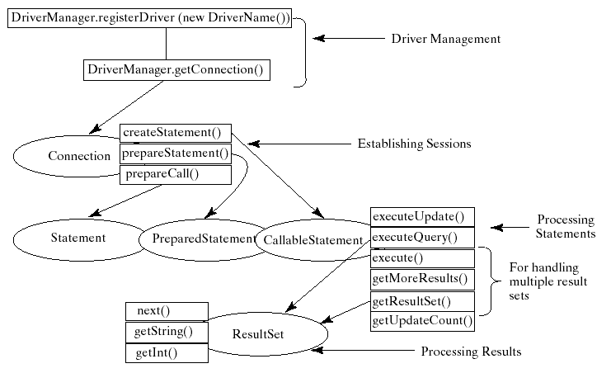
Processing Statements Diagram

Slide 31
The execute, executeQuery, and executeUpdate Methods
The methods for executing SQL statements are execute, executeQuery, and executeUpdate, each of which accepts a string containing a SQL statement as an argument. This string is passed to the database for execution. The execute method should be used if the execution produces multiple result sets, multiple update counts, or a combination of result sets and update counts.

Slide 32
The execute, executeQuery, and executeUpdate Methods, cont.
The executeQuery method should be used if the execution produces a single result set, such as the SQL select statement. The executeUpdate method should be used if the statement results in a single update count or no update count, such as a SQL INSERT, DELETE, UPDATE, or DDL statement.

Slide 33
PreparedStatement
The PreparedStatement interface is designed to execute dynamic SQL statements and SQL-stored procedures with IN parameters. These SQL statements and stored procedures are precompiled for efficient use when repeatedly executed.
Statement pstmt = connection.prepareStatement
("insert into Student (firstName, mi, lastName) +
values (?, ?, ?)");

Slide 34
Example:
Using PreparedStatement to Execute Dynamic SQL Statements
This example rewrites the preceding example using PreparedStatement.
FindGradeUsingPreparedStatement
Run

